Slide 1
Mining Association Rules ——From Association Mining to Correlation Analysis——
徐华
清华大学 计算机系 智能技术与系统国家重点实验室
xuhua@tsinghua.edu.cn

Slide 2
Association and Correlations
Association and Correlations
Efficient and Scalable Frequent Itemset Mining Methods
Mining Various Kinds of Association Rules
From Association Mining to Correlation Analysis
Constraint-based Association Mining

Slide 3
Interestingness Measure: Correlations (Lift)
play basketball ⇒ eat cereal (谷物)[40%, 66.7%] is misleading
The overall percentage of students eating cereal is 75% which is higher than 66.7%.
play basketball ⇒ not eat cereal [20%, 33.3%] is more accurate, although with lower support and confidence
Measure of dependent/correlated events: lift
 | Basketball | Not basketball | Sum (row)
Cereal | 2000 | 1750 | 3750
Not cereal | 1000 | 250 | 1250
Sum(col.) | 3000 | 2000 | 5000

Slide 4
Are All the Rules Found Interesting?
“Buy walnuts(胡桃) ⇒ buy milk [1%, 80%]” is misleading
if 85% of customers buy milk
Support and confidence are not good to represent correlations
So many interestingness measures? (Tan, Kumar, Sritastava @KDD’02)
 | Milk | No Milk | Sum (row)
Coffee | m, c | ~m, c | c
No Coffee | m, ~c | ~m, ~ c | ~c
Sum(col.) | m | ~m | Σ
DB | m, c | ~m, c | m~c | ~m~c | lift | all-conf | coh | χ2
A1 | 1000 | 100 | 100 | 10,000 | 9.26 | 0.91 | 0.83 | 9055
A2 | 100 | 1000 | 1000 | 100,000 | 8.44 | 0.09 | 0.05 | 670
A3 | 1000 | 100 | 10000 | 100,000 | 9.18 | 0.09 | 0.09 | 8172
A4 | 1000 | 1000 | 1000 | 1000 | 1 | 0.5 | 0.33 | 0

Slide 5
Mining Highly Correlated Patterns
lift and χ² are not good measures for correlations in transactional DBs
all-conf or coherence could be good measures (Omiecinski @TKDE’03)
Both all-conf and coherence have the downward closure property
Efficient algorithms can be derived for mining (Lee et al. @ICDM’03sub)
DB | m, c | ~m, c | m~c | ~m~c | lift | all-conf | coh | χ²
A1 | 1000 | 100 | 100 | 10,000 | 9.26 | 0.91 | 0.83 | 9055
A2 | 100 | 1000 | 1000 | 100,000 | 8.44 | 0.09 | 0.05 | 670
A3 | 1000 | 100 | 10000 | 100,000 | 9.18 | 0.09 | 0.09 | 8172
A4 | 1000 | 1000 | 1000 | 1000 | 1 | 0.5 | 0.33 | 0

Slide 6
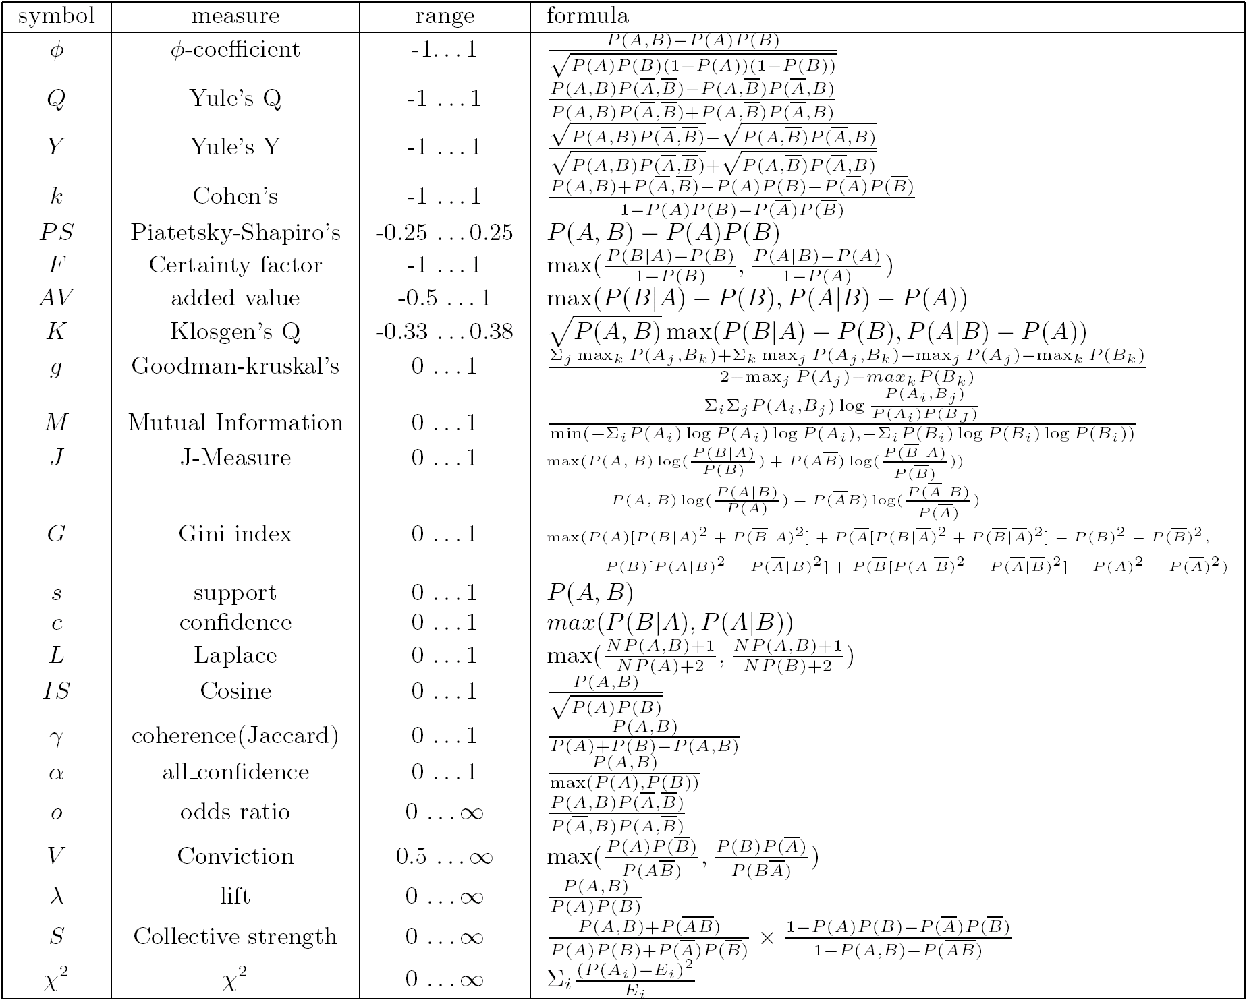
Which Measures Should Be Used?

Slide 7
Thanks！
Notes:
工作新意图发现

